Slide 1
Team 3
Dallin Gordon, Rakin Munim, Leo Zhang, Sonu Kumar

Slide 2
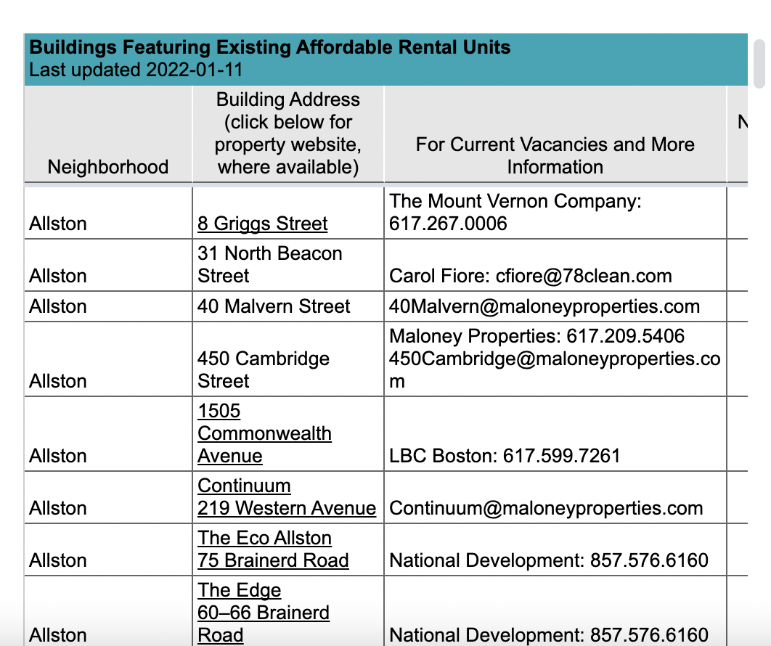
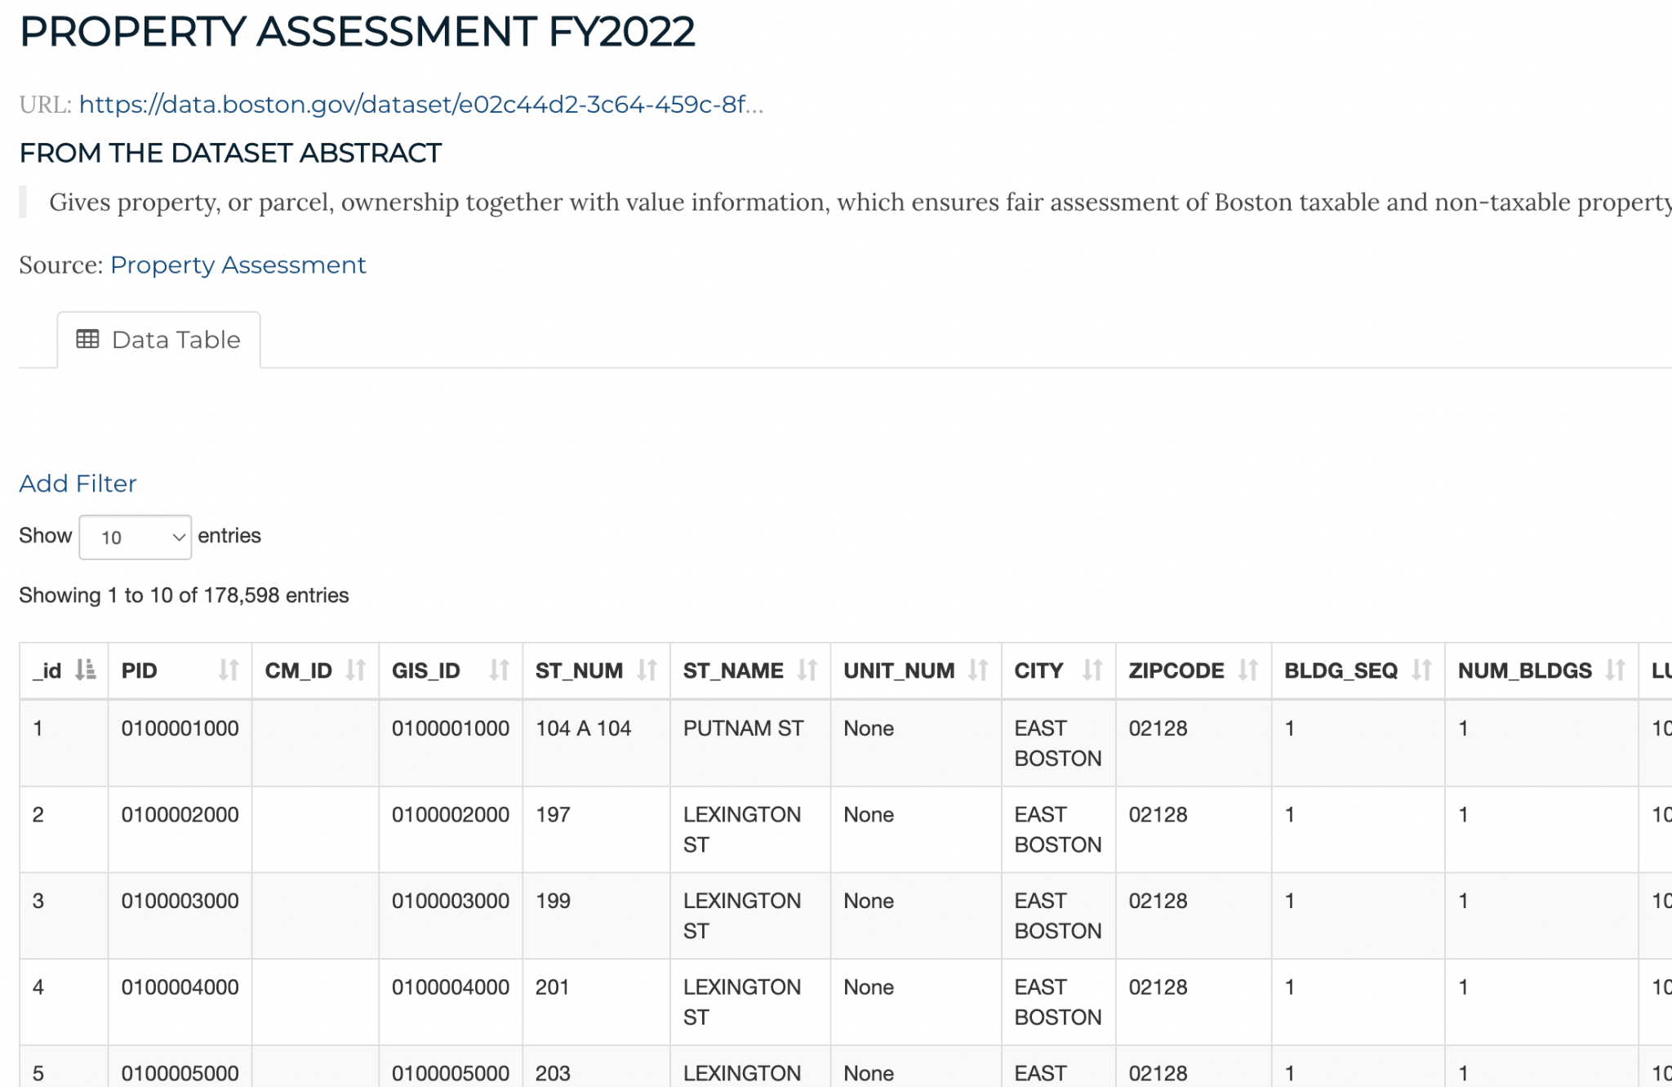
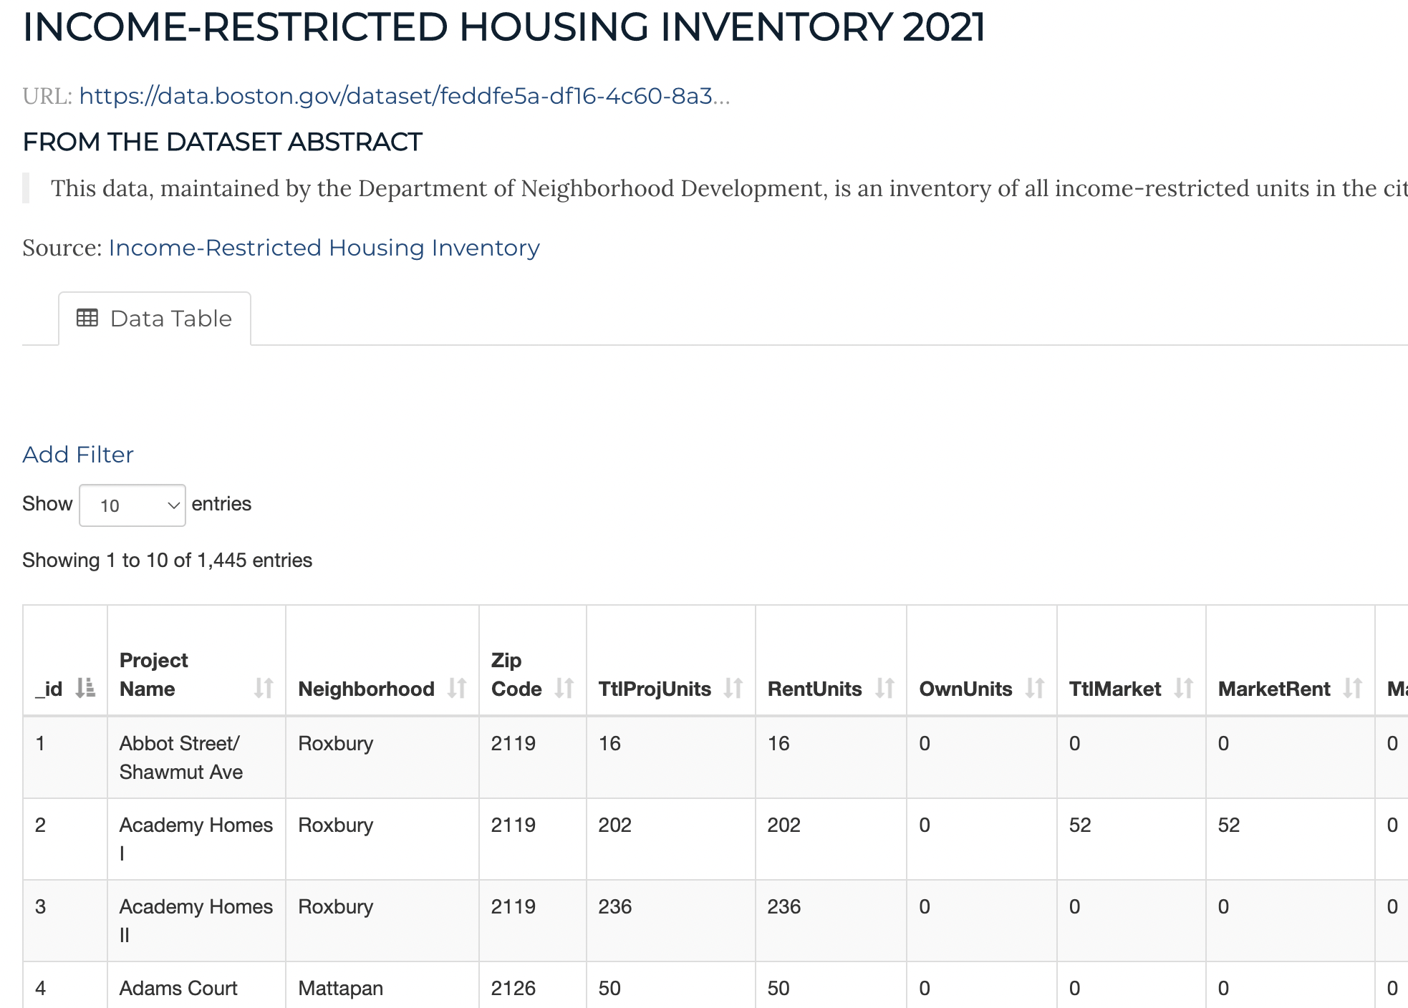
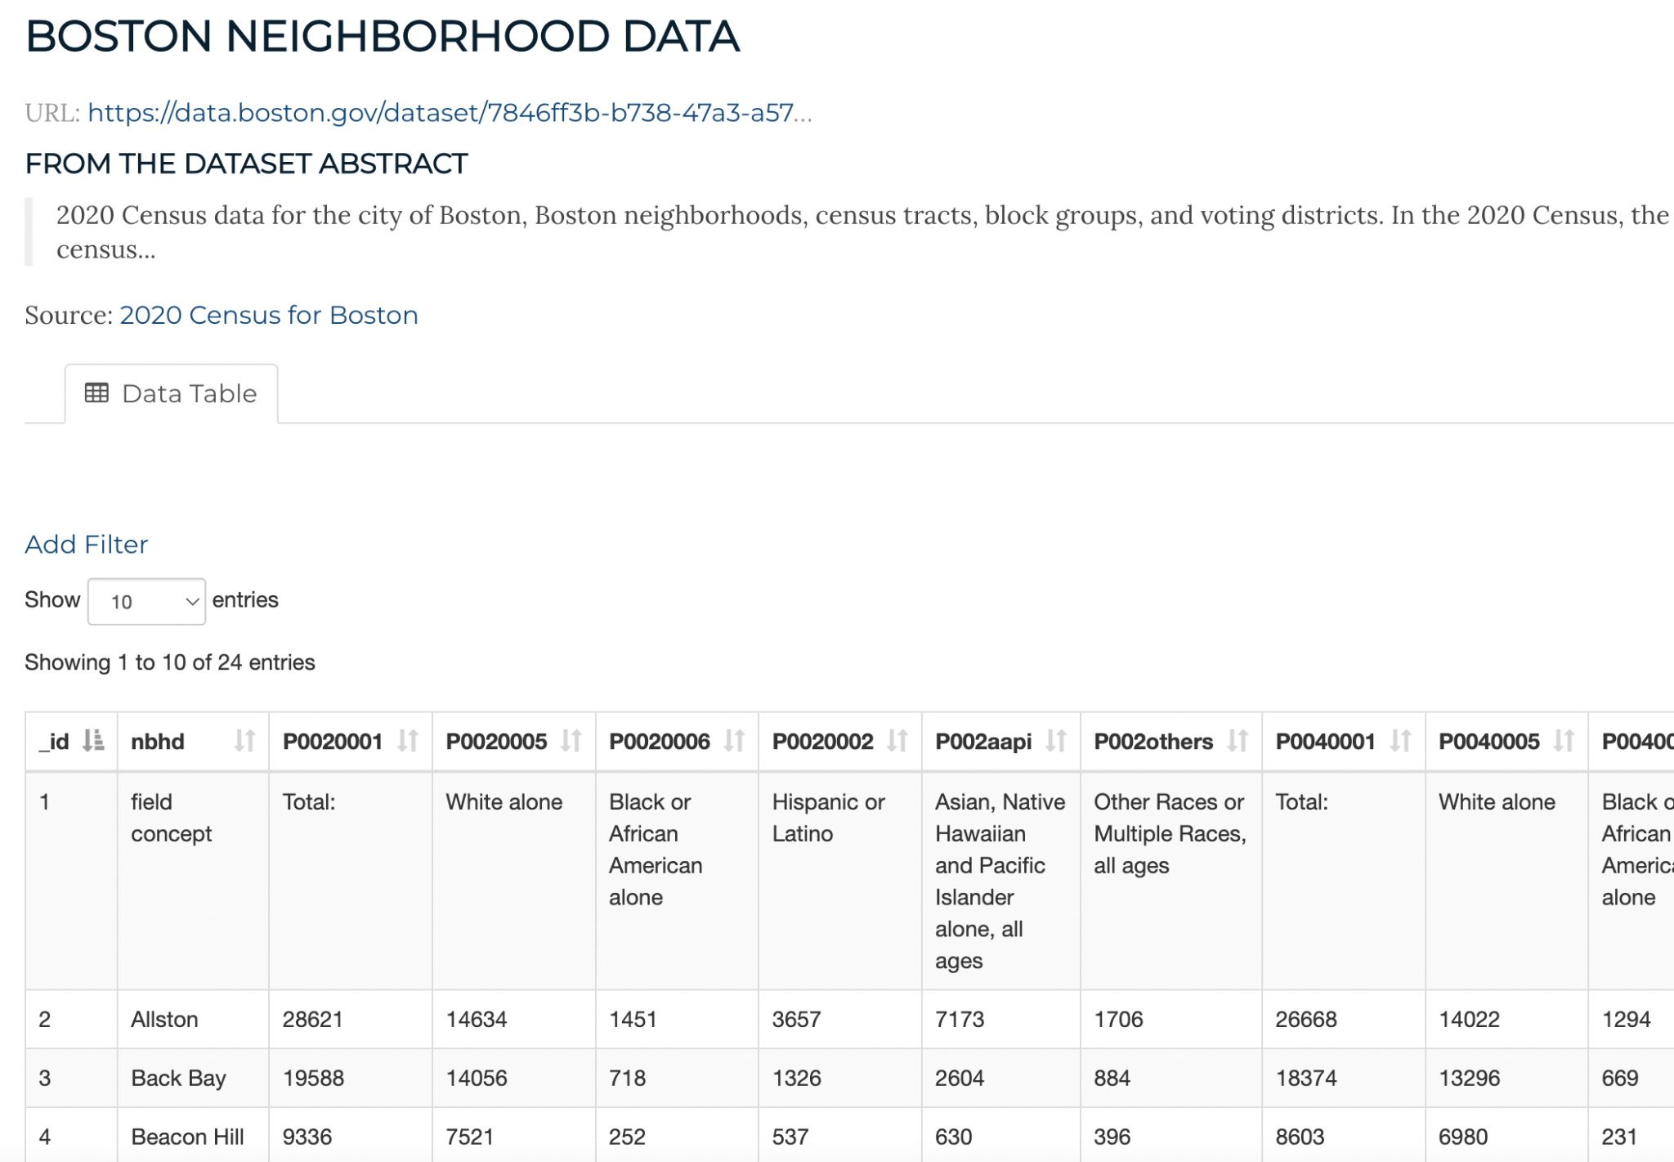
Data Sources
Notes:
Property assessment was base.
Boston affordable housing (turquoise)
Income Restricted ~2400 units that matched. -used google api. Code included, but my api key is disabled.
Census neighborhood data - not shown neighborhood area code look up, and aggregated to neighborhood.

Slide 3
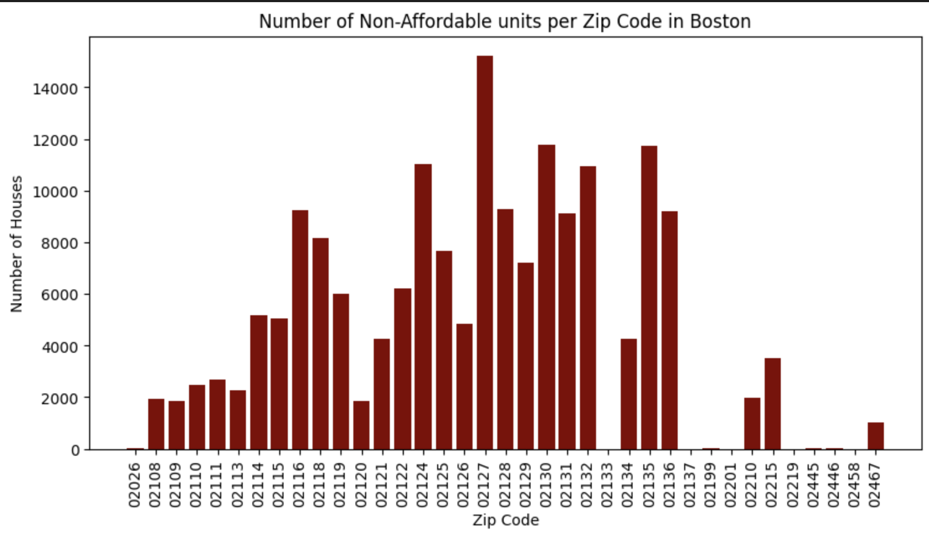
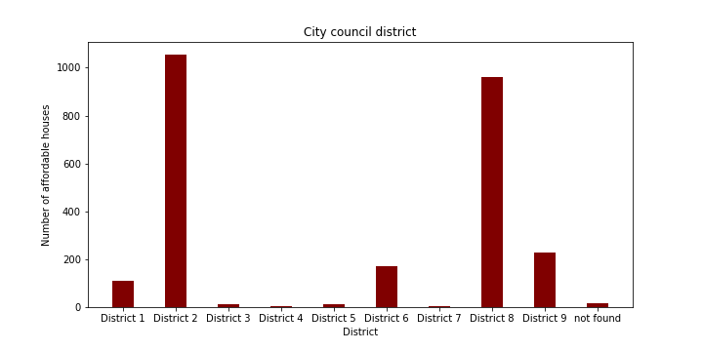
Basics
99 % of landlords are not enrolled in affordable housing programs:
Notes:
Left graph shows there seems to be a normal distribution with some zip codes having little to no housing programs at all
Right graph shows that most of affordable housing is located in two districts. This is definitely something to look into since heavy concentration is might not mean good equity.

Slide 4
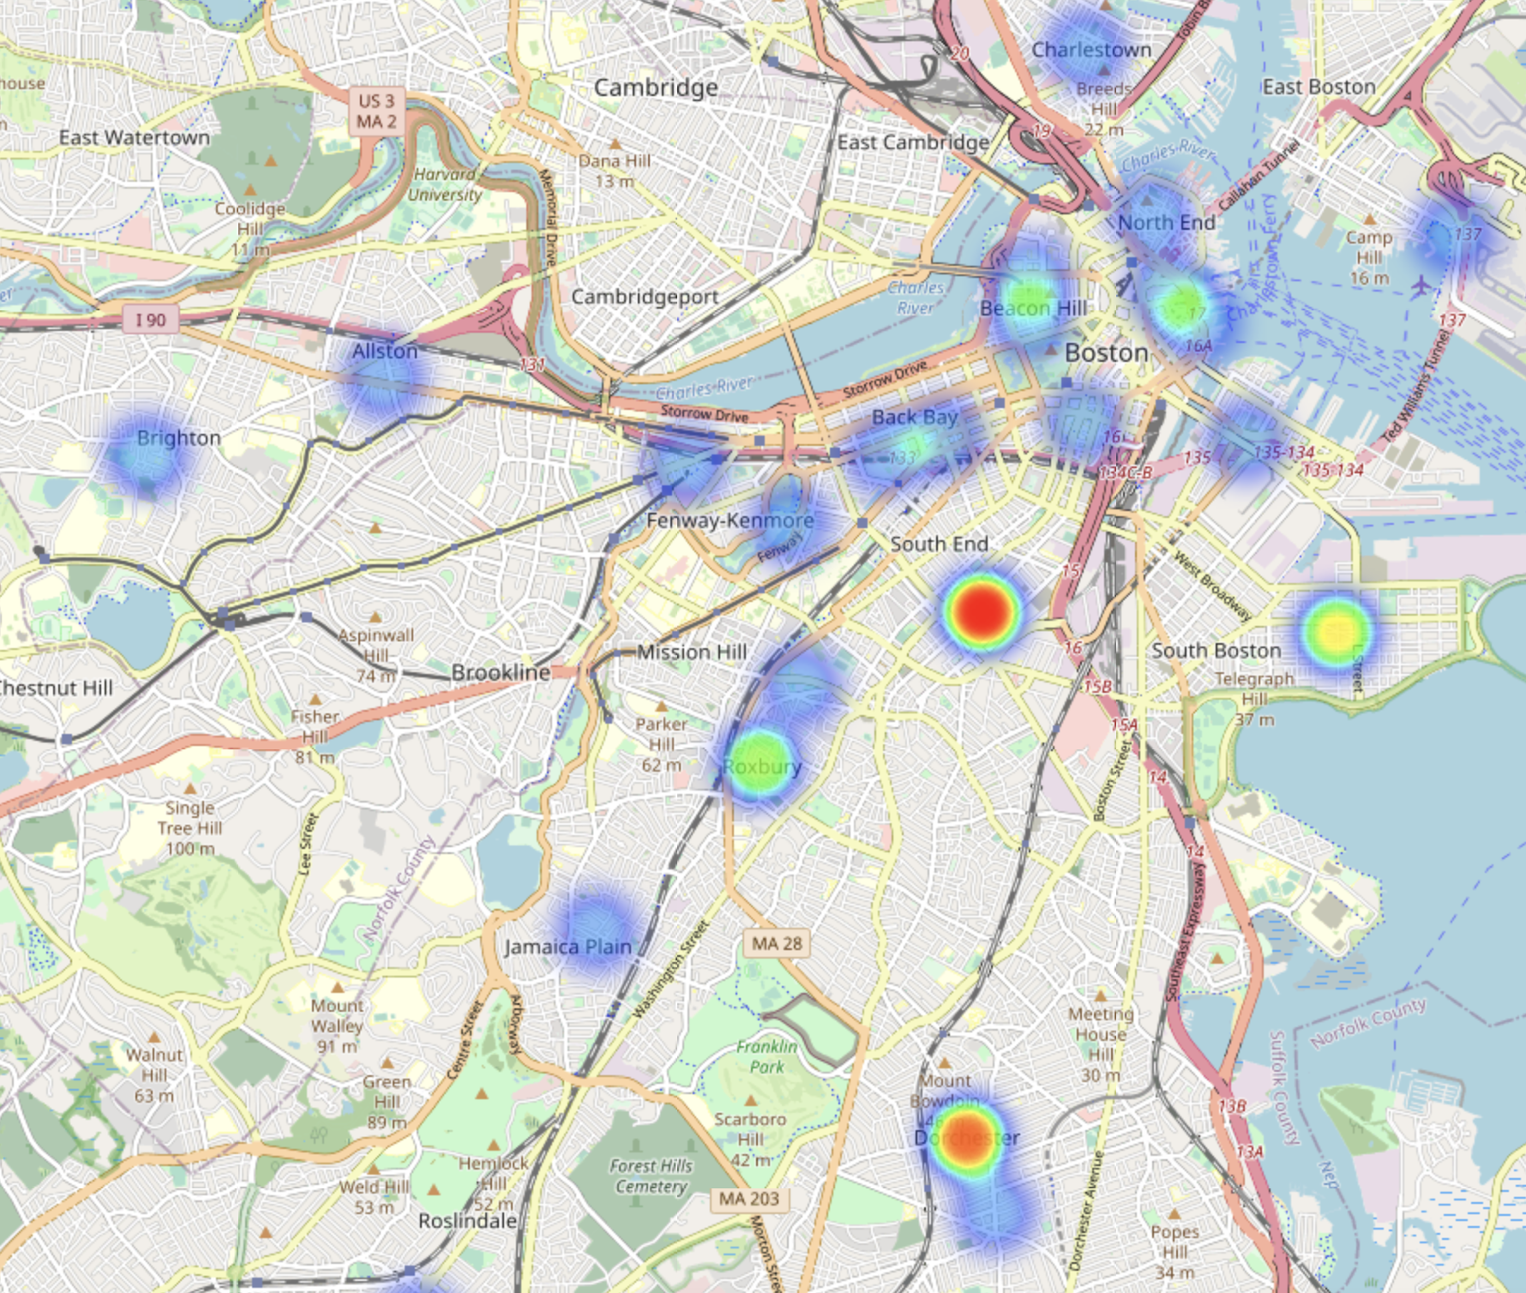
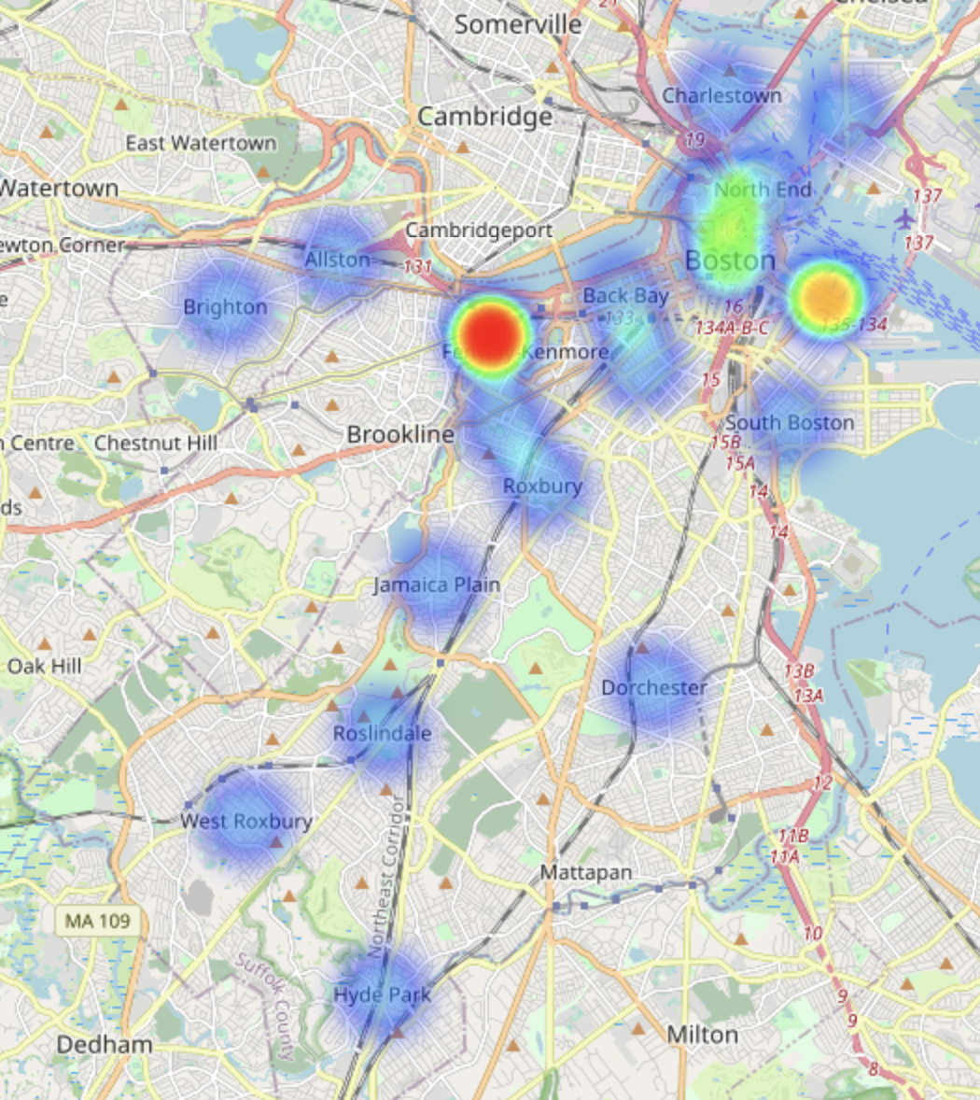
Basics
Visualization of spread
Notes:
Left graph shows affordable housing distribution
Right graph shows income restricted housing -
we see heavy concentration in areas for both charts geographically and lots of zones with sparse areas.

Slide 5
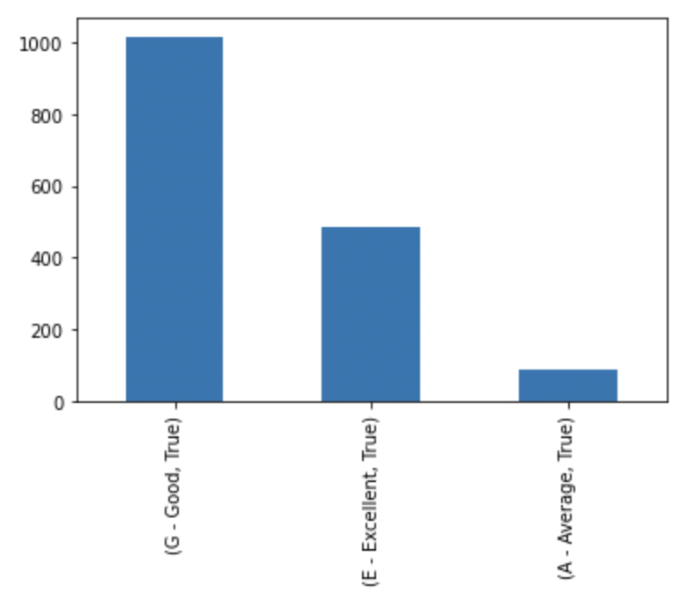
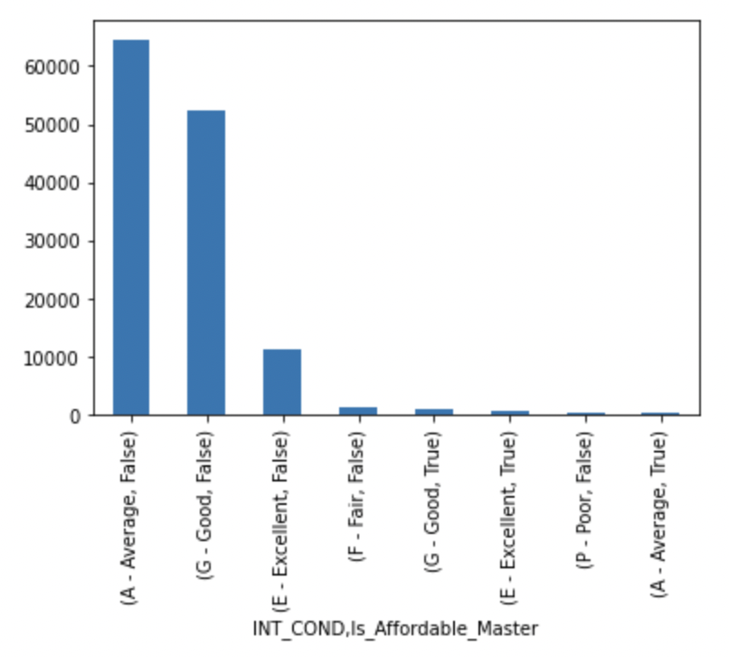
Bias - Quality
Affordable Units
All Units
Notes:
The big column on the left is Good, there are very few average units included in the affordable housing data we had access to. Average dominates in all others. False means not in affordable, true was. (the left graph is in the right graph)

Slide 6
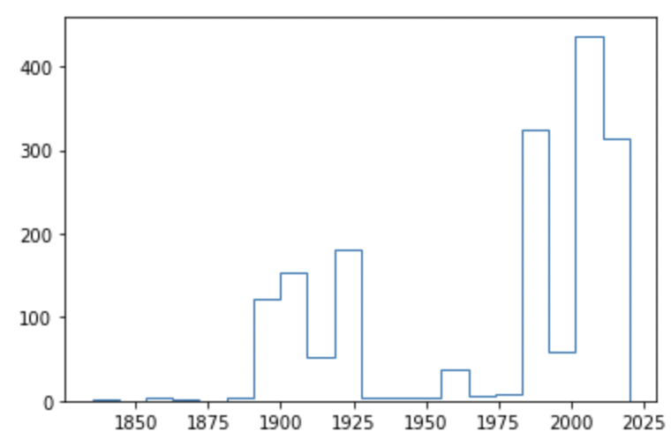
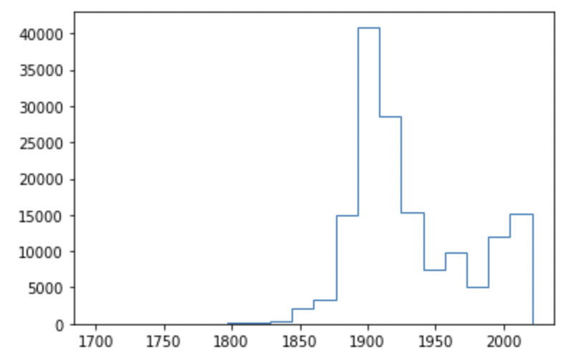
Bias - Year Built
Affordable Units
All Units
Notes:
The gap is strange. Is this historical buildings? Then the most are 90s or later. All units show a much less surprising distribution for an expensive urban area. These look cherry picked to some degree.

Slide 7
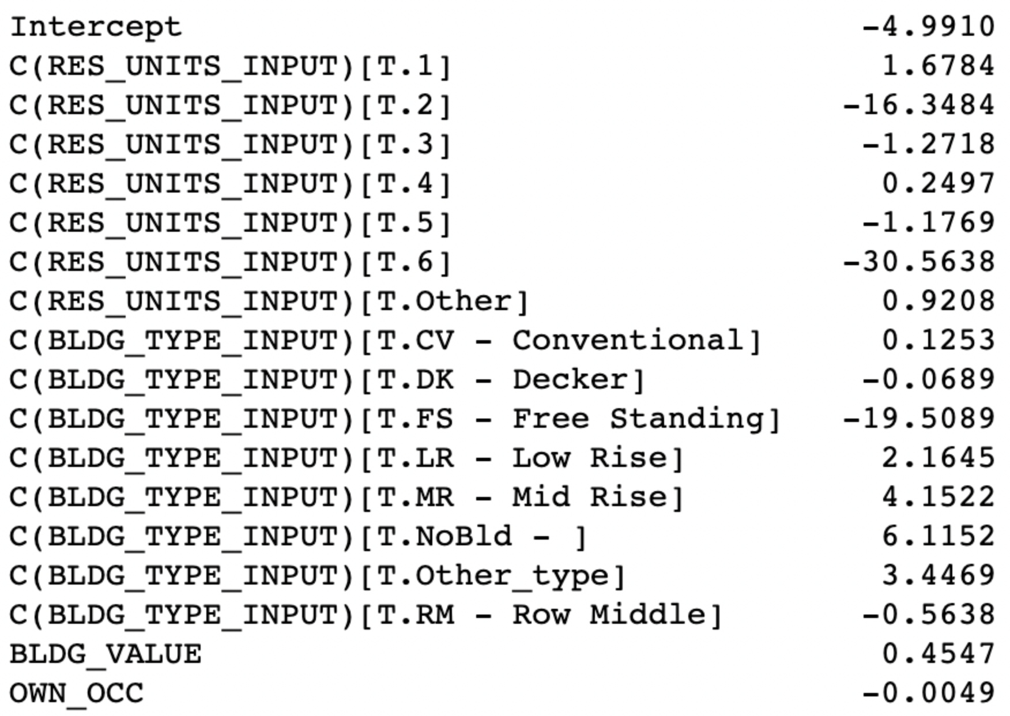
Regression Scheme
Sampled (used 2000 affordable units and 5000 randomly sampled from other units)
Res_Units:1 consistently positive, other (>6) consistently positive
Bldg_Type NoBld and Mid Rise both high and similar
Bldg_Value positive. Bias correlation?
Own_Occ close to zero to be expected if this has not been explored.
Regression 2/3
Notes:
Schem: 3 regressions, left off area code (made obvious in later slide). Wanted to be explanatory and predictive.

Slide 8
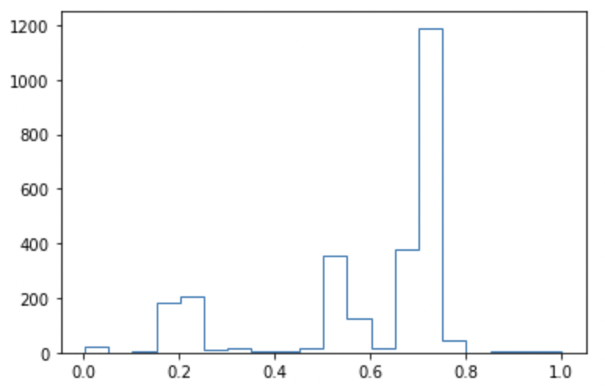
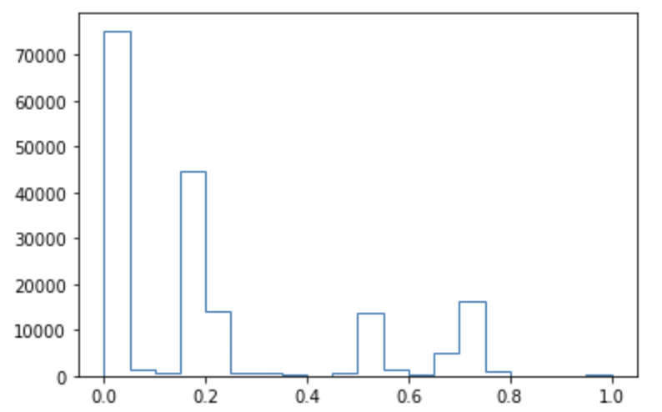
Predictions
Results in Master_with_regression_output.csv
Affordable Units
All Other Units
Notes:
Our regression predictions. We left it as probability so they are rankable. We expect more above 0.5 for the affordable, and many fewer for all other. Those above 0.5 are where we suggest looking to add new units.

Slide 9
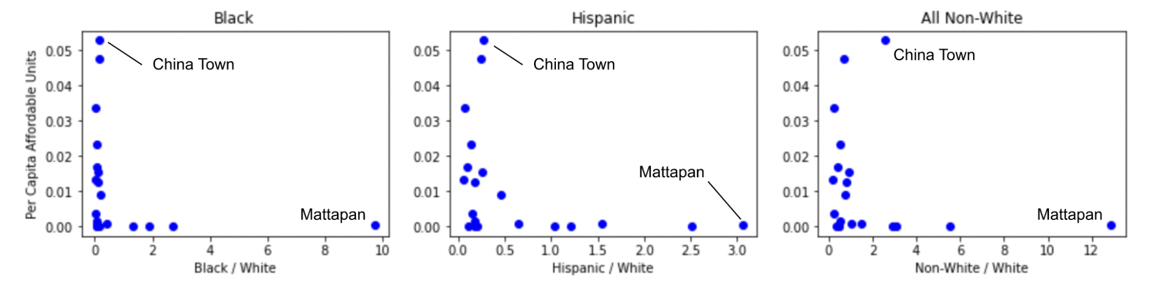
Underserved Neighborhoods
Notes:
Aggregated the first 3 datasets (at the grain of property assessment) and joined to the census neighborhood data.
Y axis: affordable units per capita (total neighborhood population) Higher is better affordable coverage
X axis: Minority group / White population. Farther to the right is a less white population.
Boston has lots of very white neighborhoods.
And of the non-white ones, its pretty terrible.
If this is cherry picked…you can see where the best places are going.
Mattapan 73 units predicted
Instructions in our paper on how to use our master csv to filter this by neighborhood, buyt own_occ, etc. and then have a way to rank those. Start with units that we think have a better chance, or rather, have more in common with units in the listing.

Slide 10
How to use our code base:
Google document with documentation highlighting how to use our code base
Our recommended notebooks to pick up from:
File: masterDataAnalysis.ipynb
Data Source: Is_Affordable_Master_Dataset.csv (IAM) (Team generated)
Usage Instructions: This notebook uses the joined dataset we created from the affordable housing dataset and income restricted data set. The IAM dataset performed an inner join on both datasets giving us a complete single dataset without repeats
File: data explore.ipynb
Data Sources:
https://www.bostonplans.org/housing/finding-housing/property-listings
https://data.boston.gov/dataset/property-assessment
Usage Instructions: This notebook is used for analysis of affordable housing dataset and the 2020 Property assessment dataset. This notebook is a very useful since these two datasets are part of the the code datasets for this project.

Slide 11
How to use our code base: cont’d
DataSet: Is_Affordable_Master_Dataset.csv
Usage: Contains an exclusive join between the affordable housing dataset and income restricted housing dataset. The key columns to keep in mind are:
Income_restricted_inv
Existing_affordable_inv
Is_Affordable_Master
This data set contains the join of all affordable housing and income restricted housing. This dataset is extremely valuable in navigating between ‘affordable housing’ as a whole instead of having them in separate datasets

Slide 12
Looking Forward
What else can the data tell us?
Comparisons to continental US cities
Comparisons to surrounding cities
What other data sets can we use?
Long time data analytics to identify trends with respect to time
Long term racial data
Notes:
What else can the data tell us? So far we have been able to retrieve basics of where affordable housing is located in terms of area, participation rates, etc and for the extension we’ve analyzed racial trends. Since the datasets have been exclusively in the Boston area, a comparison to other cities such as New York, LA, Seattle, etc could tell us alot more about how Boston’s affordable housing program stacks up globally. Secondly we could also get more data about the surrounding cities and and compare to those cities.
What other datasets can we use?
The datasets we haven been given have been from very recent times, and while fresh data is valuable, seeing data in the context of a longer time line would be much more valuable. For example getting affordable housing data set for each year of the last decade would allow us to show how affordable housing is changing in terms of location, availability, count, etc.
This data analysis paired up with long term analysis on racial data could point to biases or negative trends that are occurring.

